Slide 1
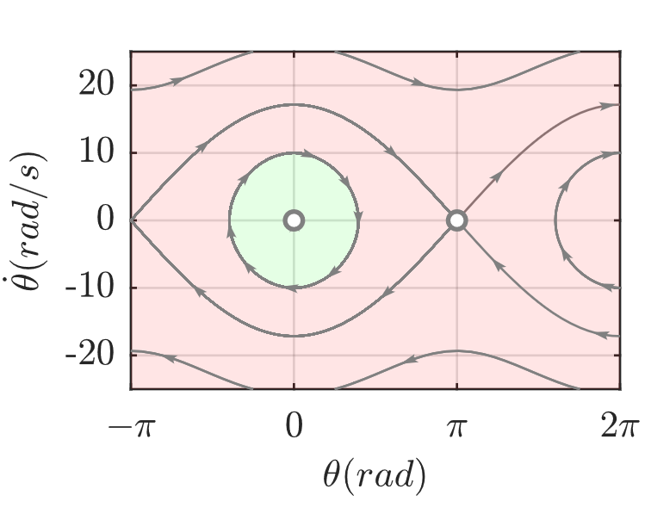

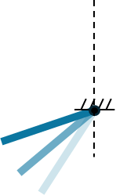

A
3
2
1
1
2
3
B
Data collection
(Free dropping)
target
train
Torque-limited
pendulum
Planning
Balancing
Reservoir controller
Underactuated robot

Slide 2

A
B
$$x(t+5δ)$$
$$x(t)$$
$$x(t+δ)$$
$$x=\left[\begin{aligned}θ \\ \dot{θ} \\ \ddot{θ}\end{aligned}\right]$$
Robot
$$x(t+δ)$$
$$τ_{a}$$
$$x(t)$$
$$x(t+5δ)$$
$$θ$$

Slide 3
$$const$$
$$θ$$
$$\dot{θ}$$
$$τ_{a}$$
$$θ$$
Reservoir
$$θ_{In}^{∗}$$
Robot
$${\dot{θ}}_{In}^{∗}$$
$$\dot{θ}$$
$$W_{Out}$$
$$θ_{Out}^{∗}$$
$$θ_{r}^{∗}$$
$$θ$$
$$S_{1}$$
$$S_{2}$$
$${\dot{θ}}_{r}^{∗}$$
$$S_{1}$$
$${\dot{θ}}_{Out}^{∗}$$
$$S_{2}$$
$$\dot{θ}$$
$$S_{3}$$
$$S_{4}$$
$$S_{3}$$
$$S_{4}$$

Slide 4
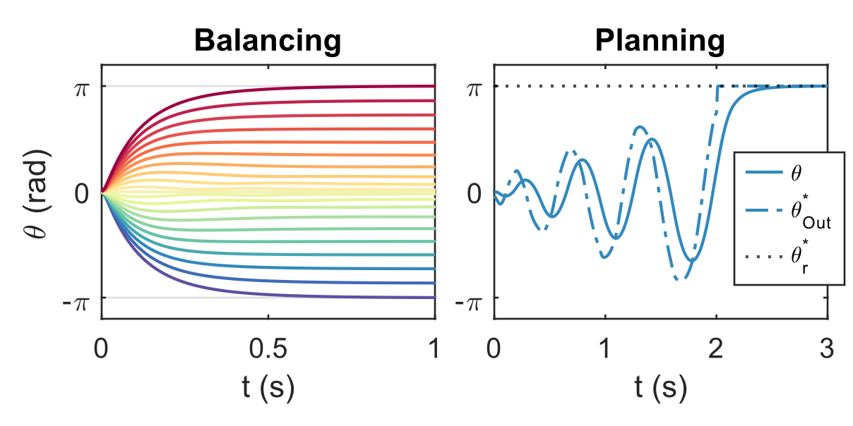
A
B

Slide 5
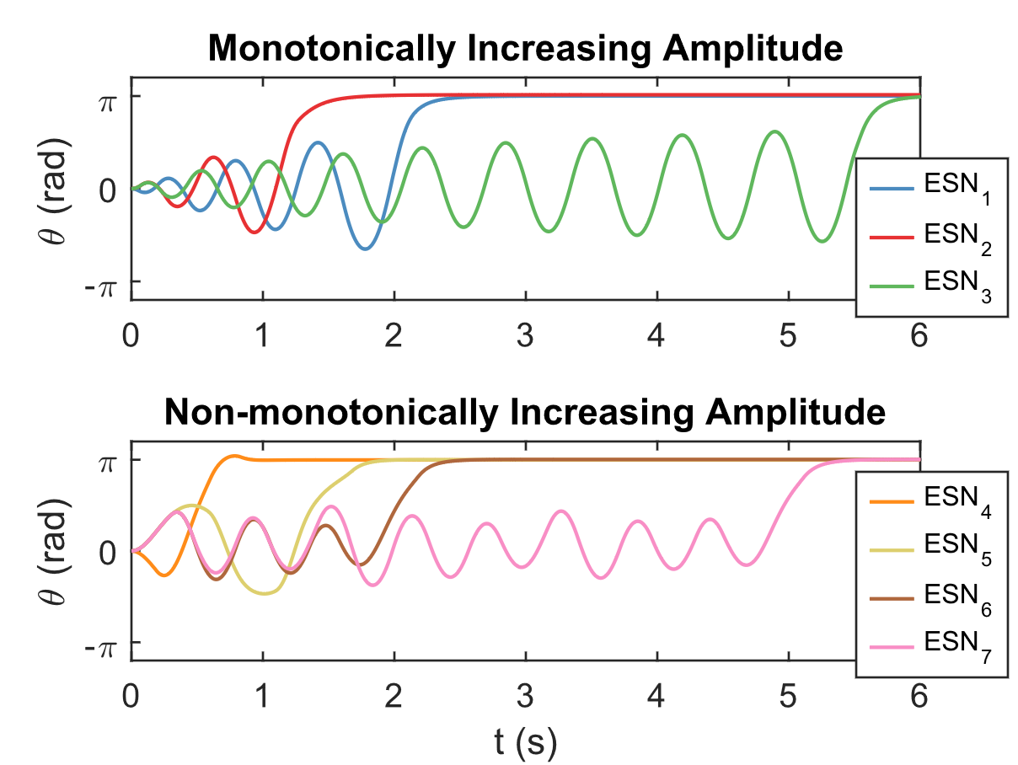
A
B

Slide 6
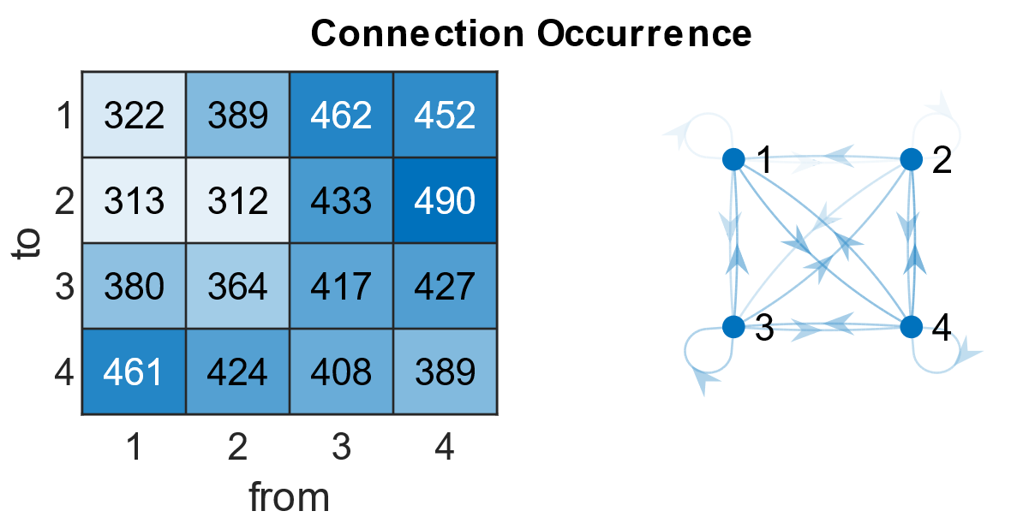
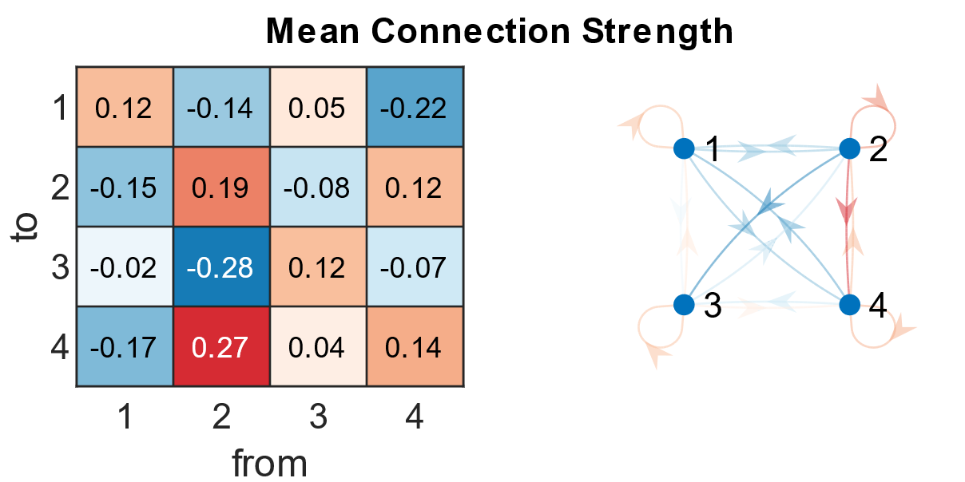
A
Rare
$$θ$$
Frequent
$$\dot{θ}$$
B
$$θ$$
$$\dot{θ}$$
Positive
Negative
Positive

Slide 7
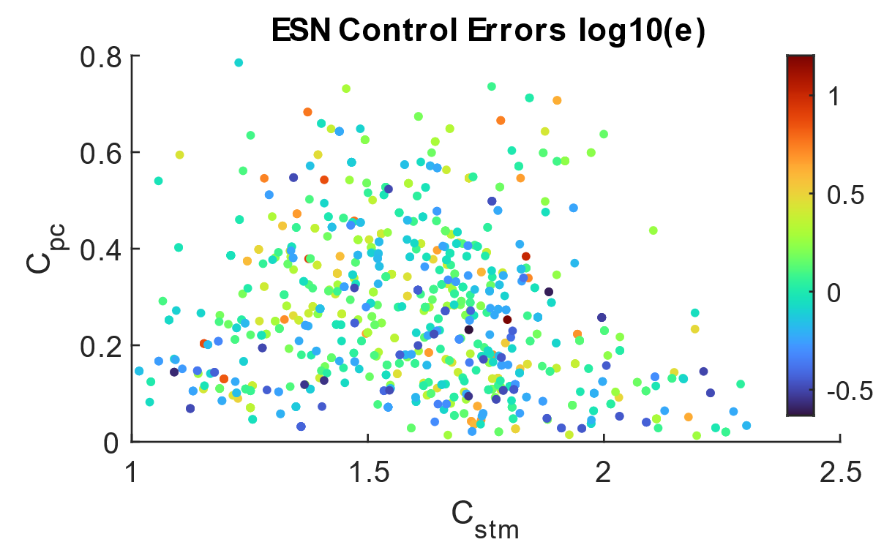

Slide 8
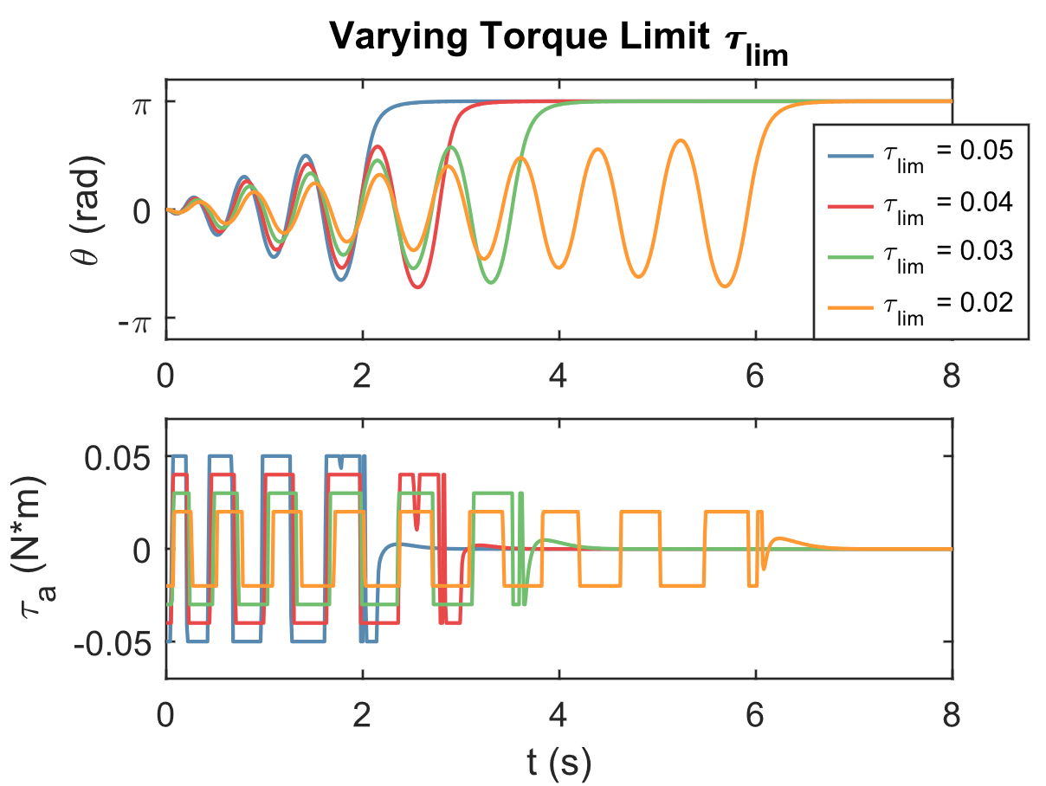
A
B

Slide 9
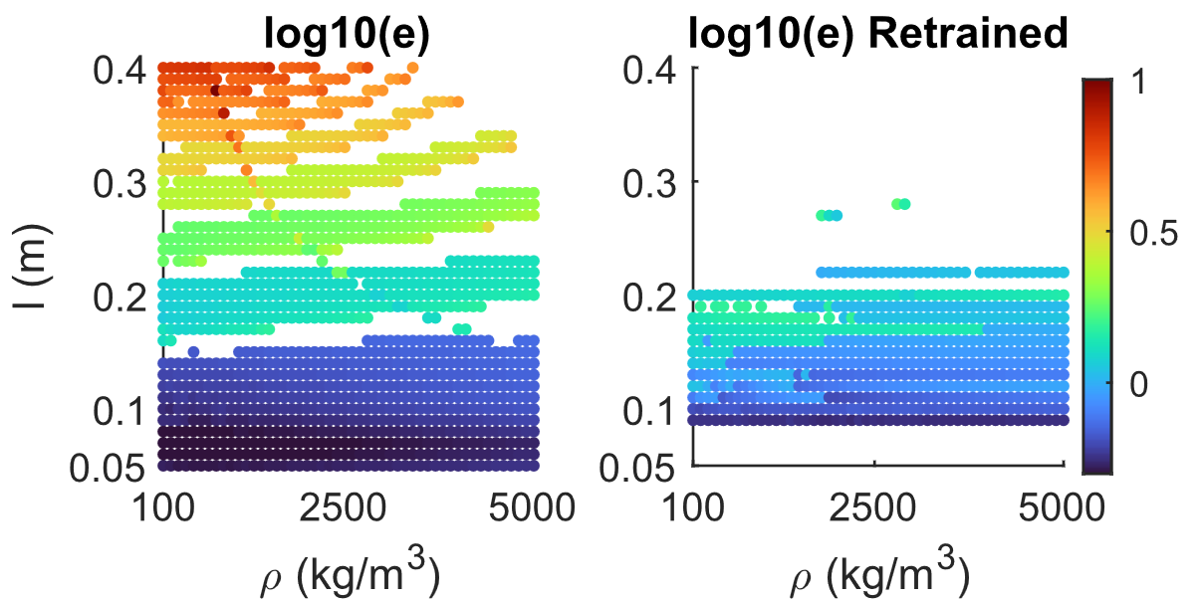
A
B

Slide 10
